Slide 1
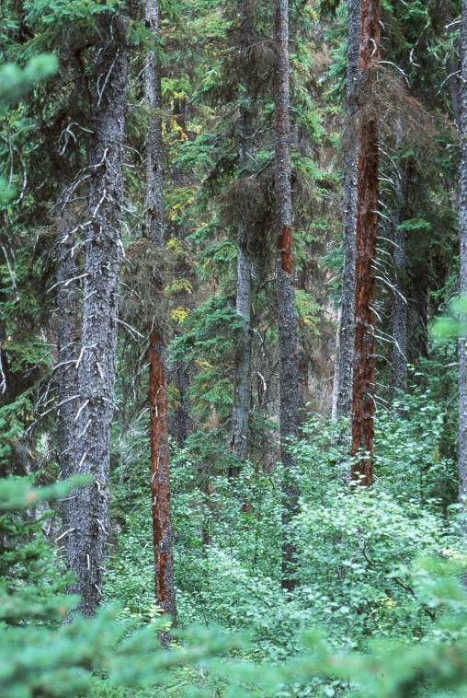
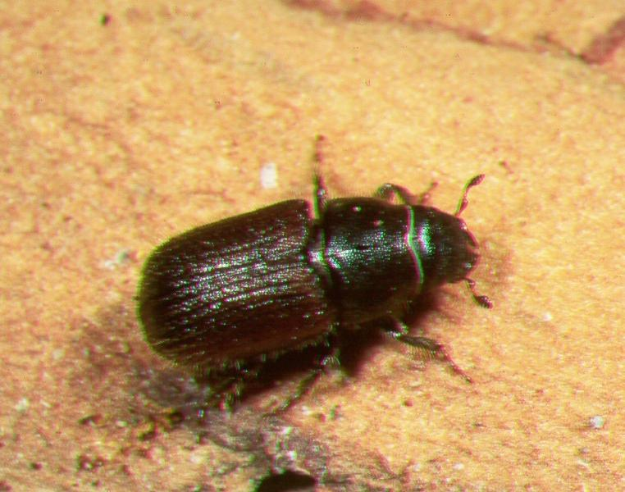
Spruce beetle
Curculionidae: Scolytinae
Dendroctonus rufipennis (Kirby)

Slide 2
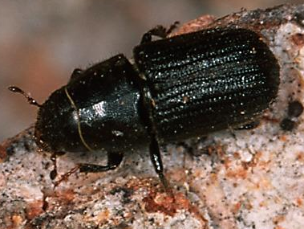
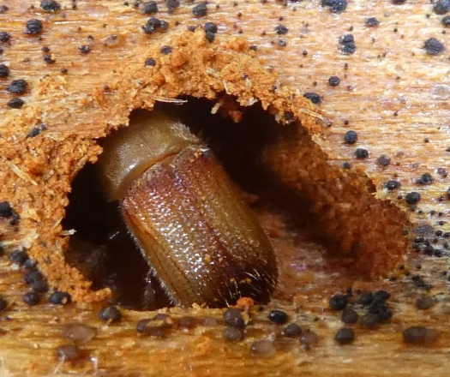
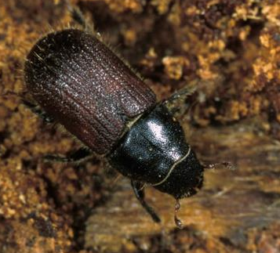
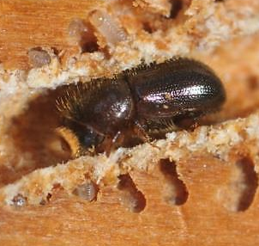
Four bark beetle species in the Southern Interior: hectares affected 2012-2016

Slide 3
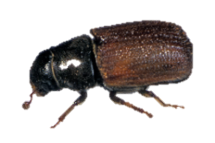
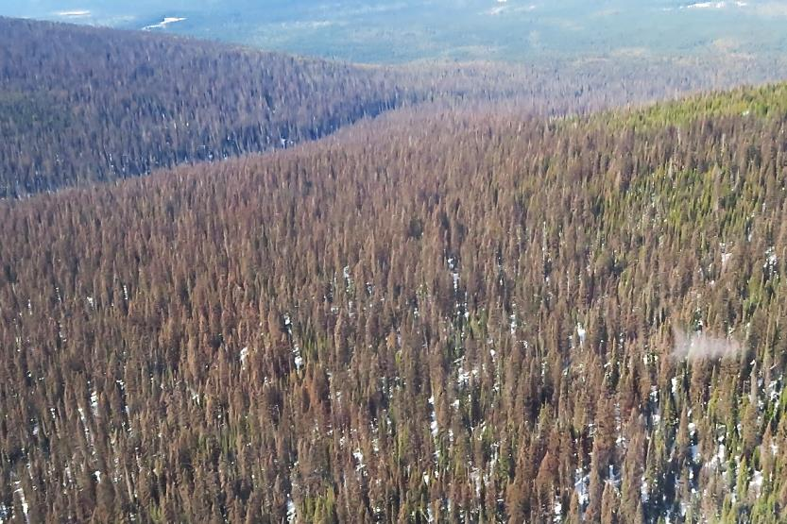
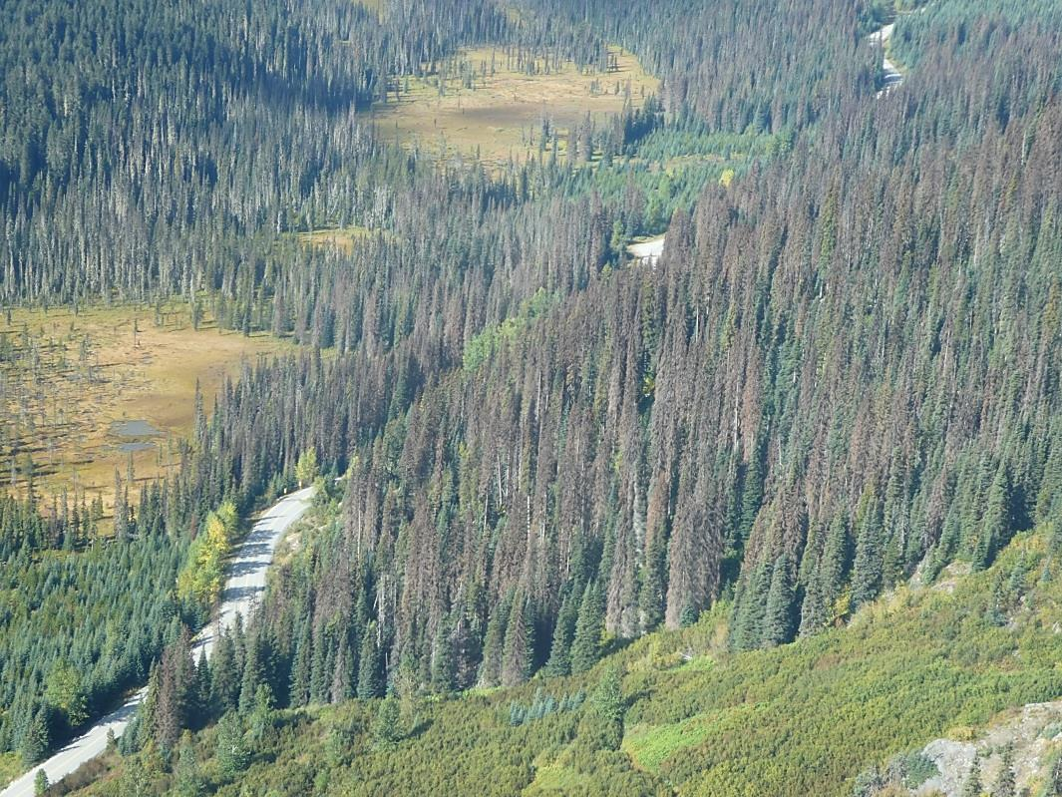
. . . things we should worry about.
Wells Gray Park
Duffy Lake area

Slide 4
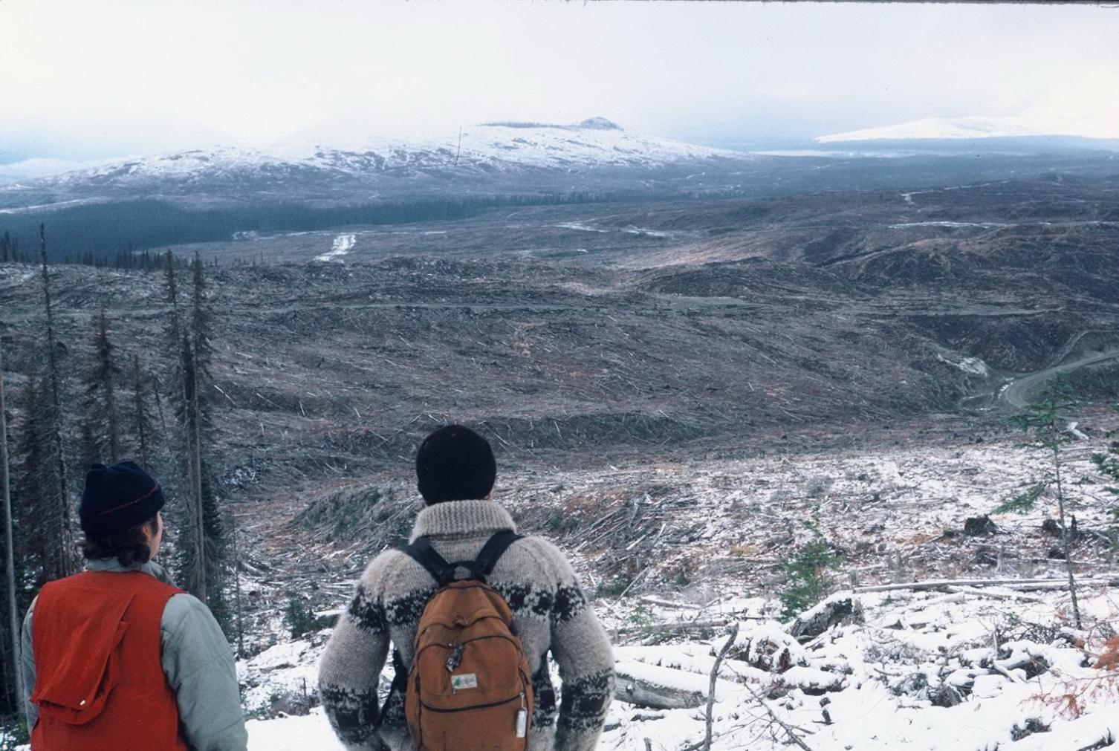
View north toward the Bowron River from an
unnamed hill in the Indian Point Creek watershed
in November 1984
Continuous
Punctuated & discrete
Photo. courtesy Robert Hodgkinson

Slide 5
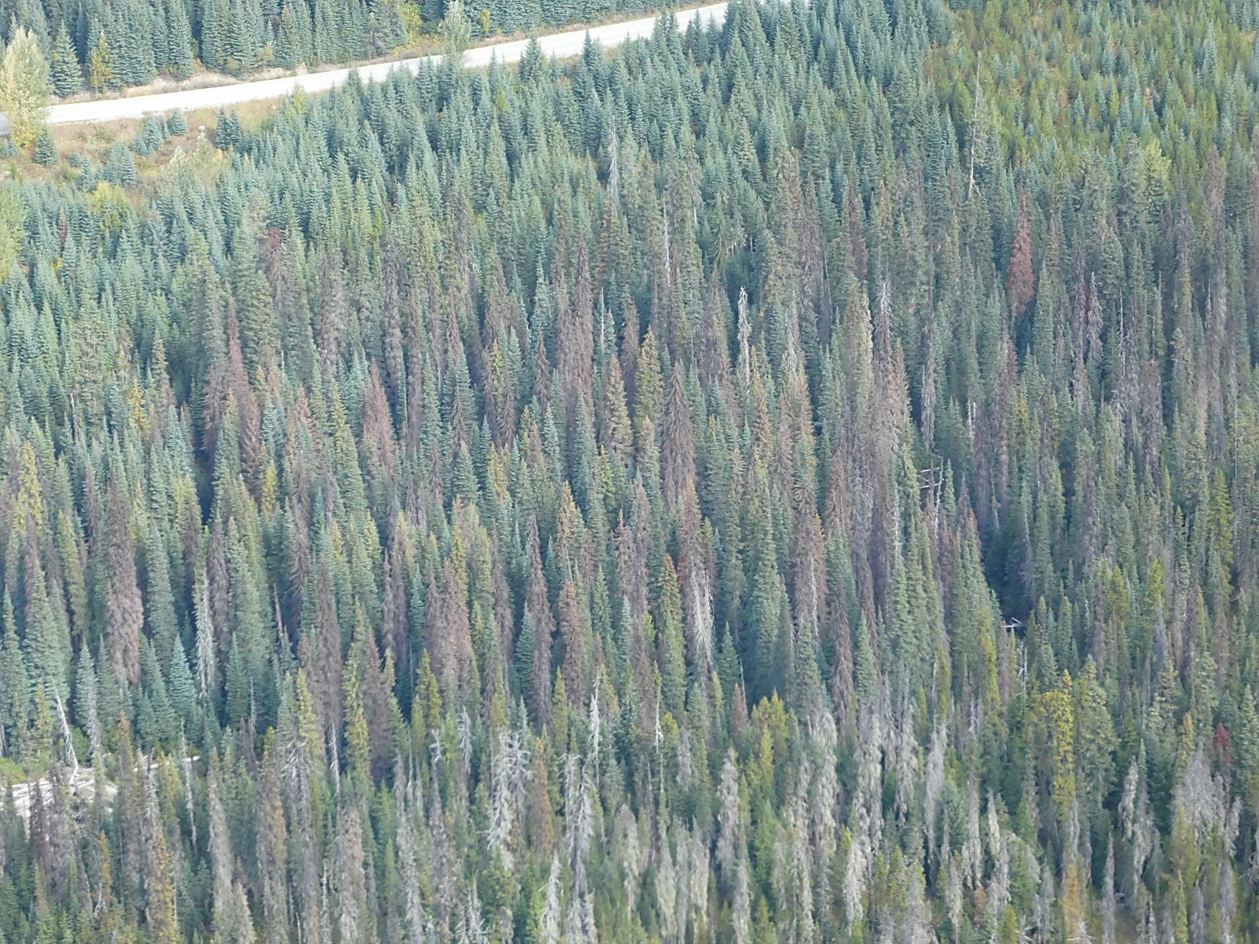
Differential fade in spruce

Slide 6
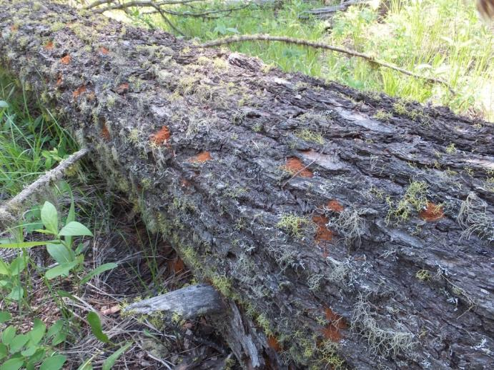
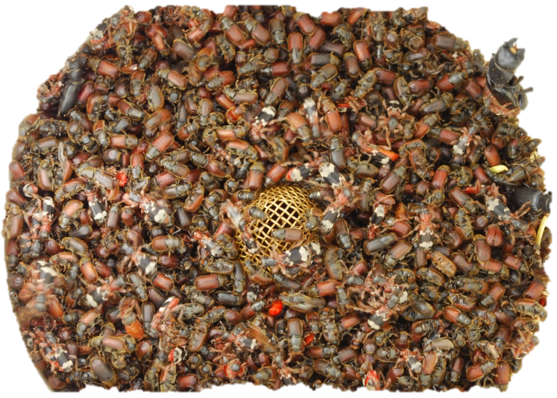
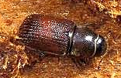
Triggers: what has affected these bark beetles?
outbreak periodicity and aging forests
wind/snow events causing breakage or blowdown in Df, Sx and Bl
unseasonal weather (very early, & longer warm spells)
drought events stress host trees
Douglas-fir beetle attracted to fresh windthrow
Notes:
3. Climate triggers – that will affect 1 & 2
wind/snow events that cause breakage or blowdown in Df, Sx or Bl
unseasonal weather (early spring, hotter, colder)
drought events
Snow could recede from trap trees earlier in the spring (with changing climates) allowing Douglas-fir beetles to emerge & fly earlier.
NB. When using trap trees as control – be attentive to these early, warm spring seasons and ensure all trap trees are removed from sites prior to adult emergence.
Warmer, longer summers could allow for a more pronounced and damaging second flight of fir beetle.

Slide 7
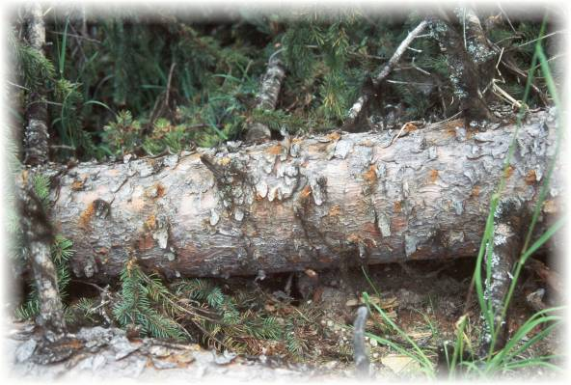
Host preference of spruce beetle:
Tree species
Engelmann (interior) spruce
White spruce
Sitka spruce
Black spruce (occasionally)
Host attributes
weakened or windthrown trees
stumps & large slash
live, standing, mature, large diameter spruce
stands composed of >65% spruce occurring in well-drained creek bottoms
unless shaded, SB will prefer underside of log to attack

Slide 8
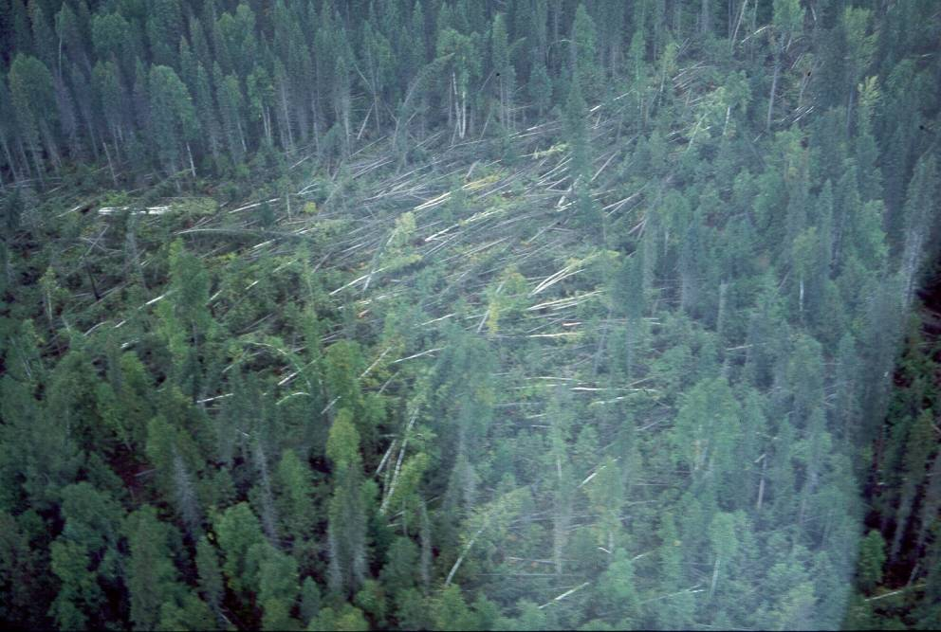
Windthrown trees

Slide 9
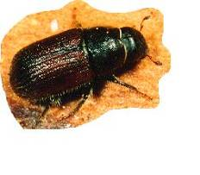
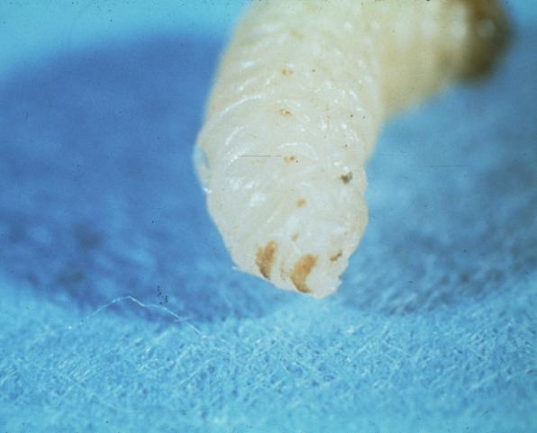
Spruce Beetle Life cycle & description
Description
adults are hard, stout-bodied & cylindrical (4.0-7.0 mm)
black-brown or black with reddish elytra
2 anal shields on larvae (only present on one other Dendroctonus, the lodgepole pine beetle)
Life Cycle
the spruce beetle usually has a two year life cycle
cycle varies from 1-3 years depending on geographic location, elevation and climatic conditions
NB. SB developing in downed hosts will often switch to univoltine

Slide 10
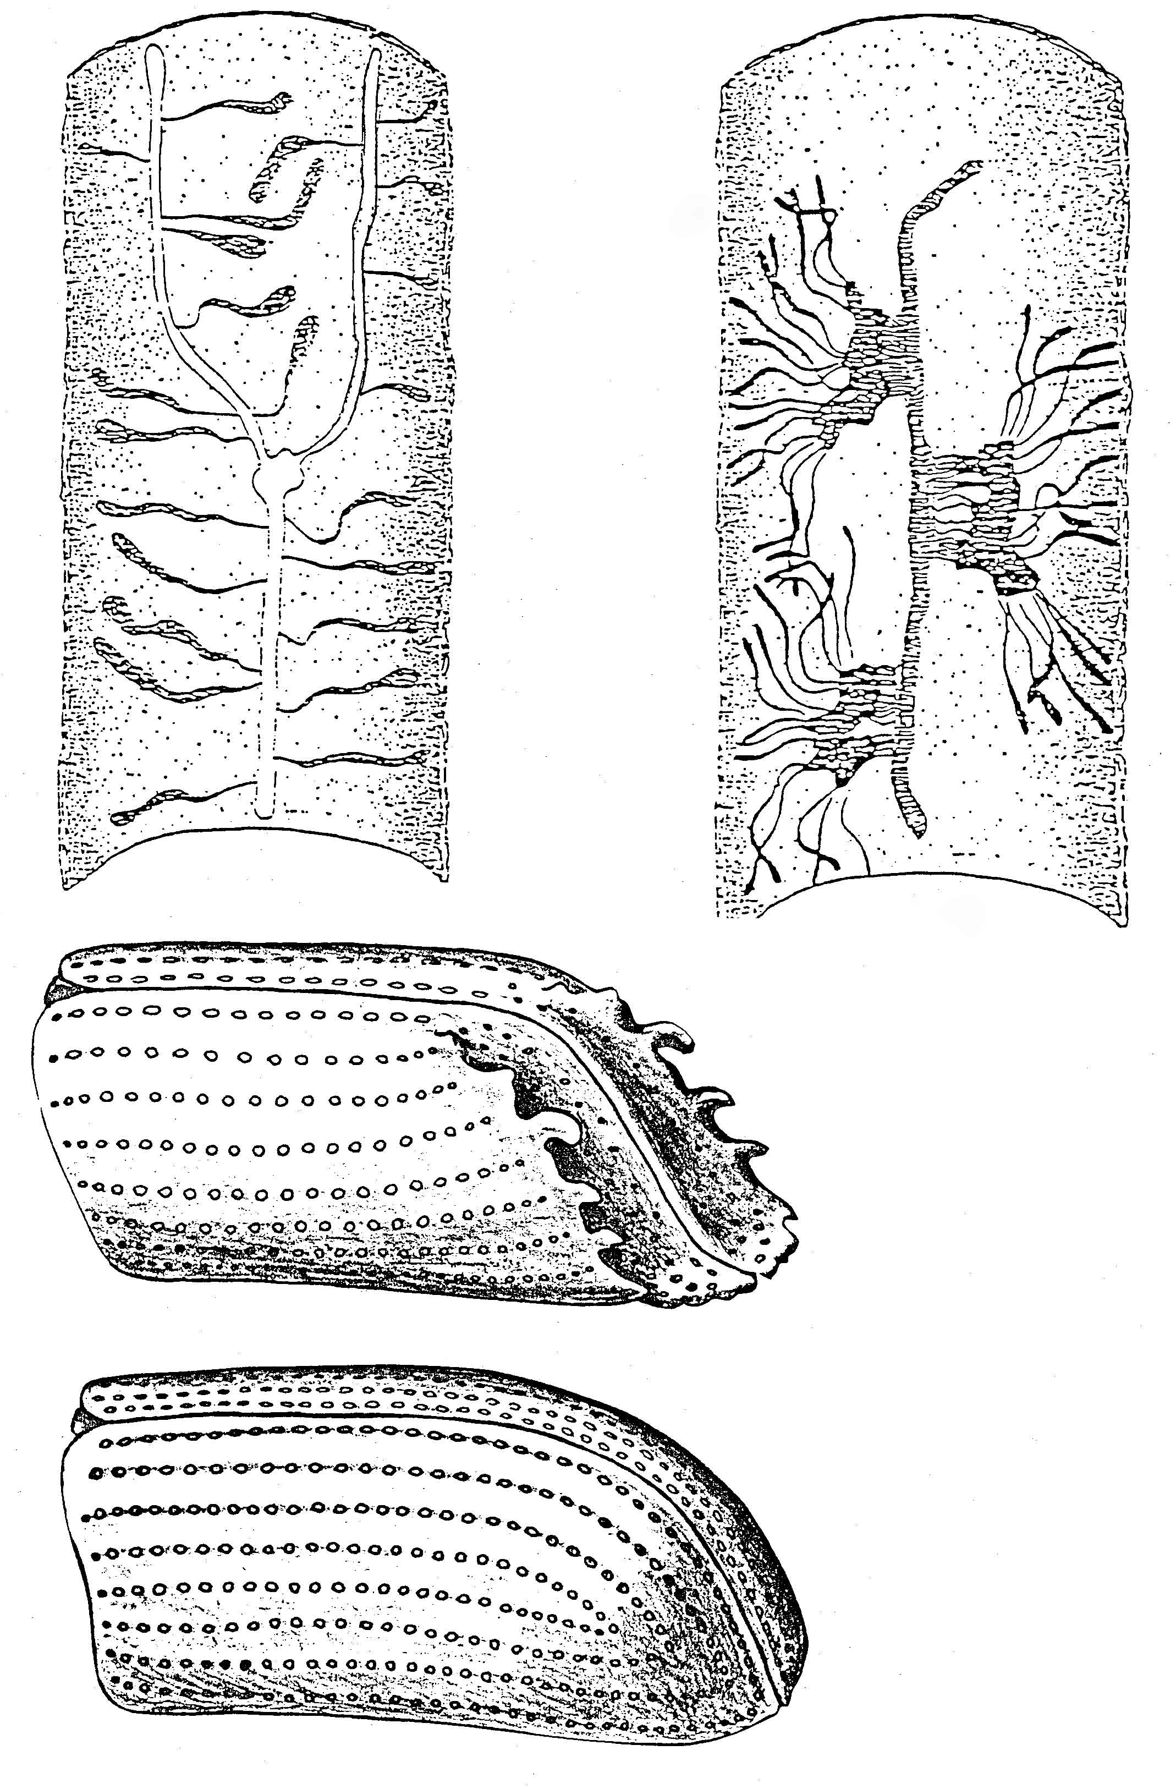
Ips
Spruce beetle
Single eggs, individual larval feeding
Group larval feeding
Ips
Concave with spines
Convex and smooth
Spruce beetle

Slide 11
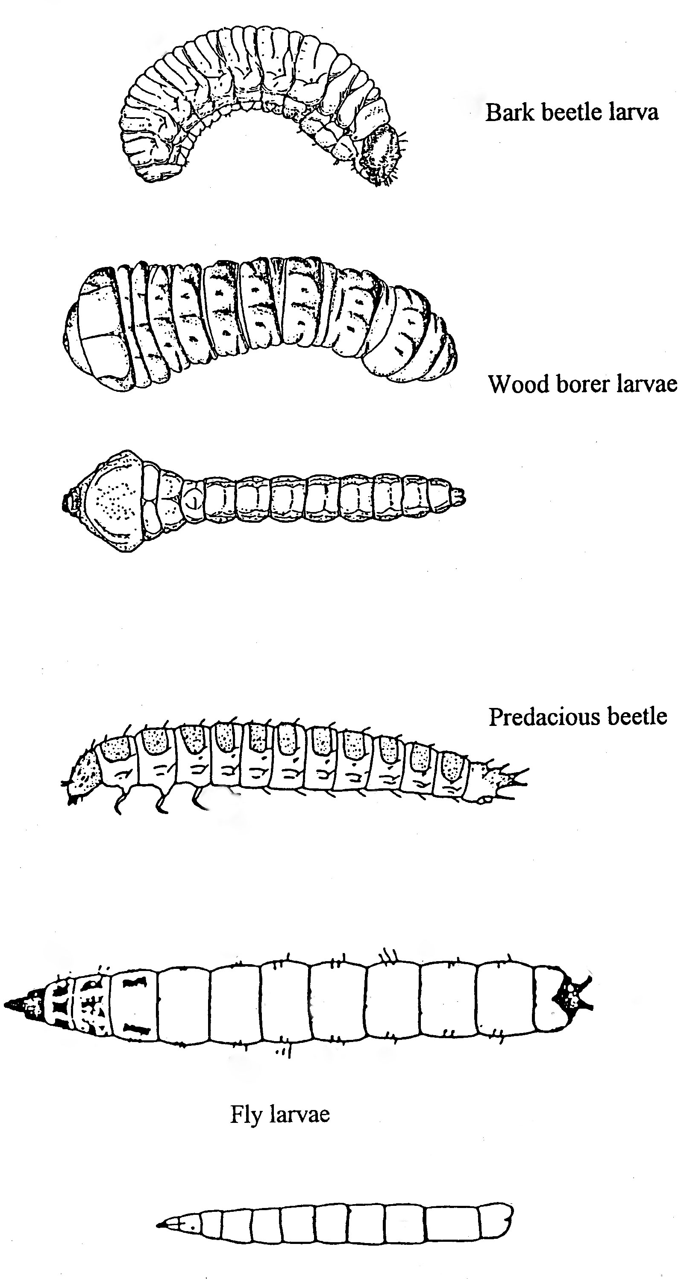
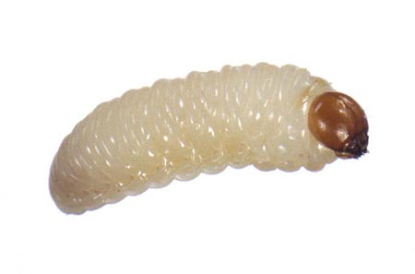
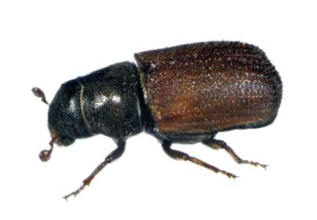
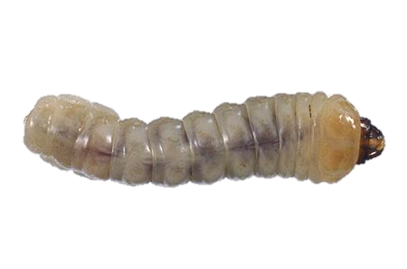
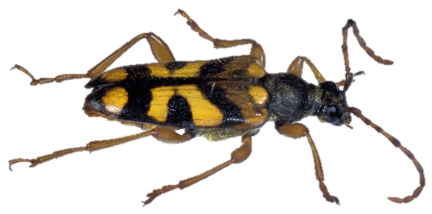
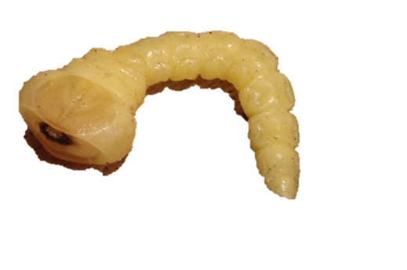
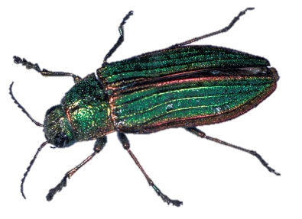
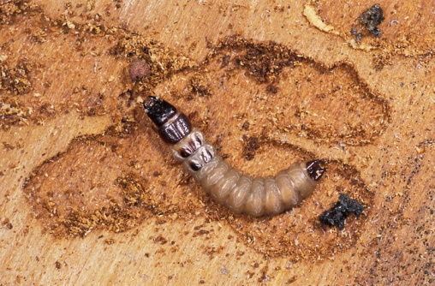
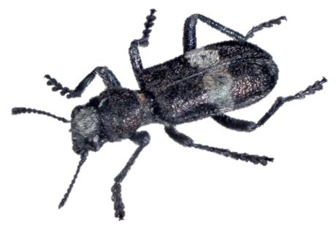
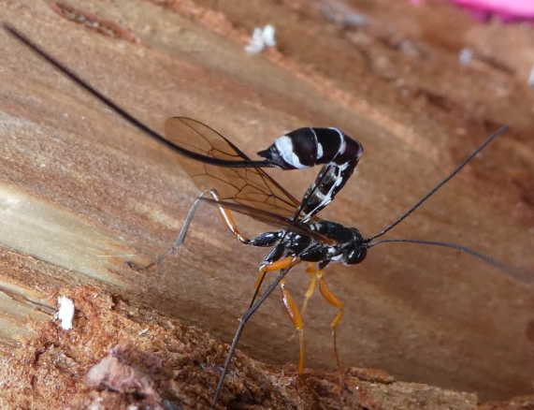

Slide 12
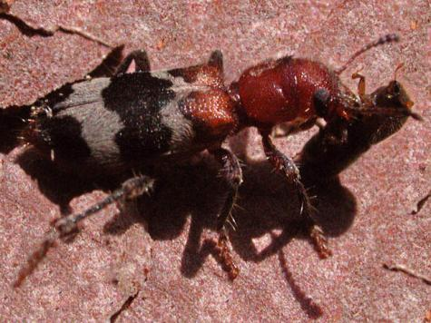
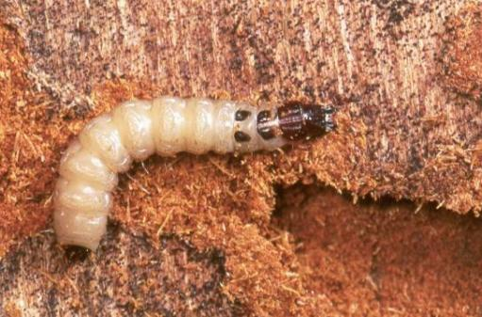
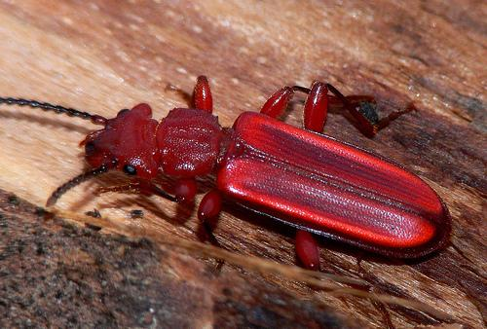
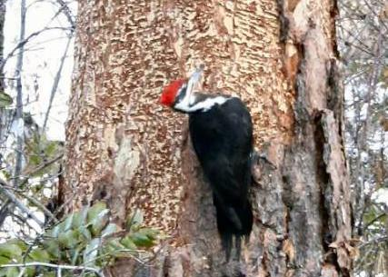
Various beetles, flies, wasps and birds are predatory or parasitic on life stages of SB.
Cleridae – predaceous in larval & adult form
Cucujidae - predaceous in adult form on bark beetles
Woodpeckers - feed on the larvae of bark beetles e.g. spruce beetle & mountain pine beetle

Slide 13
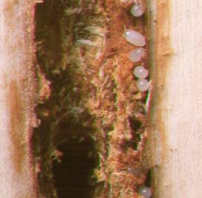
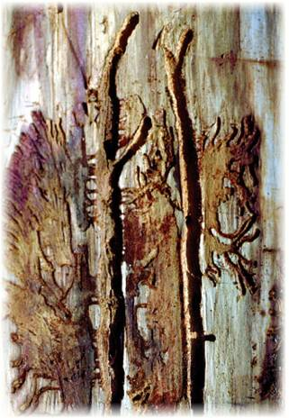
Attack May to early July
female bores into tree releasing an aggregation pheromone attracting both sexes ensuring a mass attack
eggs laid in gallery that extends upward from the entrance hole parallel to the grain of the wood
eggs laid in groups, on alternating sides of gallery
at first larvae bore out horizontally in groups
by 3rd instar, larvae mine individually & form fan-shaped galleries
brood overwinters as late instar larvae

Slide 14
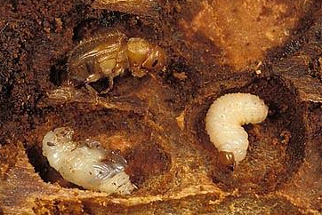
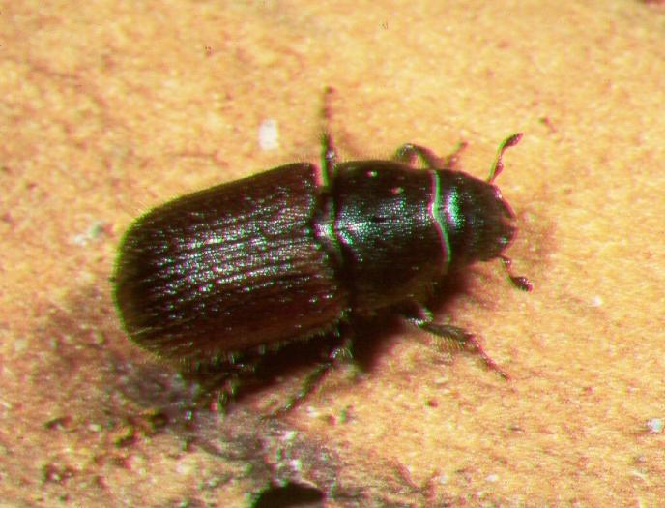
The following spring/summer they pupate and become adults
late August adults bore out of the tree and drop to the base of the tree where they bore under the bark to overwinter (not physiologically mature at this time)
Spruce beetle must overwinter once as adults prior to attacking new host trees.
the overwintered adults emerge & attack fresh host materials late May to early July

Slide 15
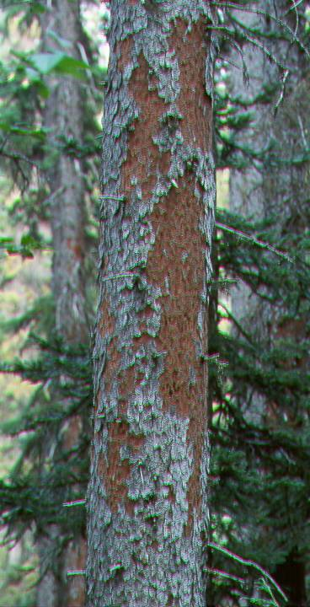
Damage & Detection
adult SB carry a blue stain fungus they introduce when they attack
the feeding of the larvae, combined with the growth of the fungus kills the tree by inhibiting the flow of food & water
woodpeckers remove bark in search of larvae (usually in first winter)

Slide 16
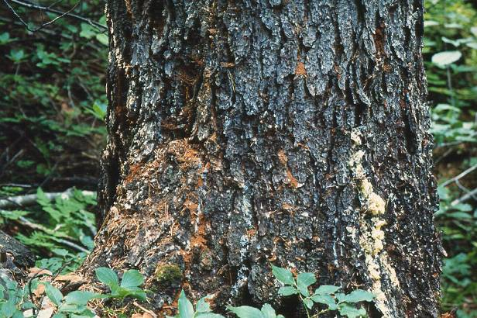
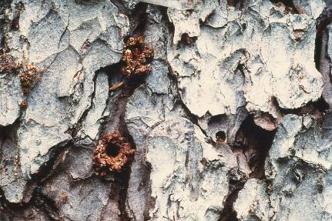
Infested trees will have light brown to red boring dust in bark crevices and at base of tree
small pitch tubes may form; when attack is late or trees have low vigour, no pitch tubes are formed
foliage colour change is unreliable - may fade from yellow to brown and then needles fall off

Slide 17
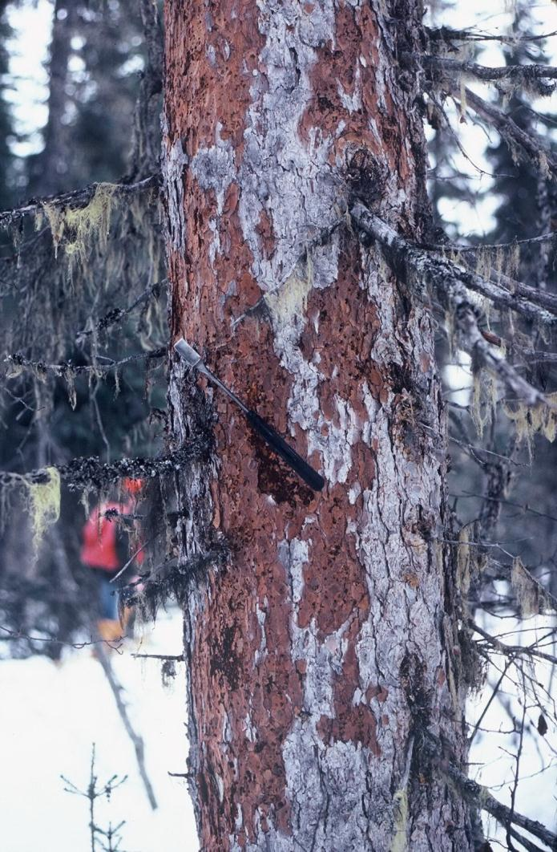
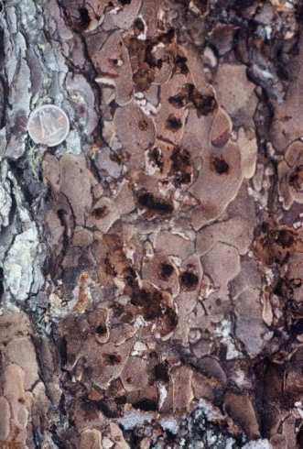
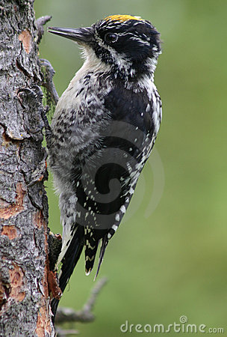
Signs of woodpeckers searching for spruce beetle larvae in spruce the first winter after beetle attack.
“Test holes”
3-toed woodpecker
Photo. courtesy Robert Hodgkinson

Slide 18
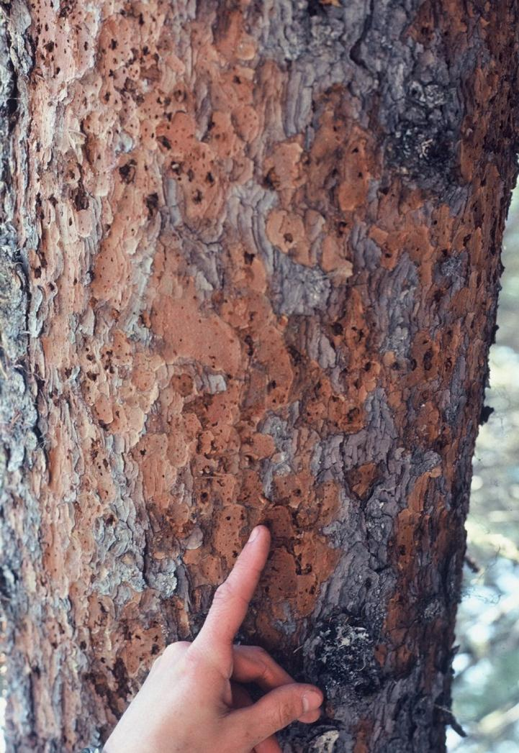
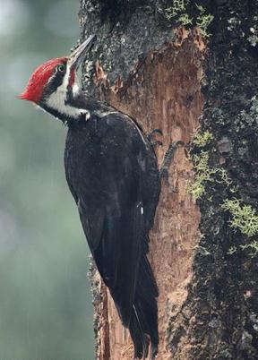
In winter when air temperatures are less than 0°C, a woodpecker can eat up to 2,200 spruce beetle larvae per day to keep up its caloric needs.
However, even though woodpeckers can directly or indirectly kill 90-95% of the beetles in a tree, the remaining beetles are sufficient to perpetuate the outbreak.
Woodpecker territoriality plays a part.
Photo. courtesy Robert Hodgkinson

Slide 19
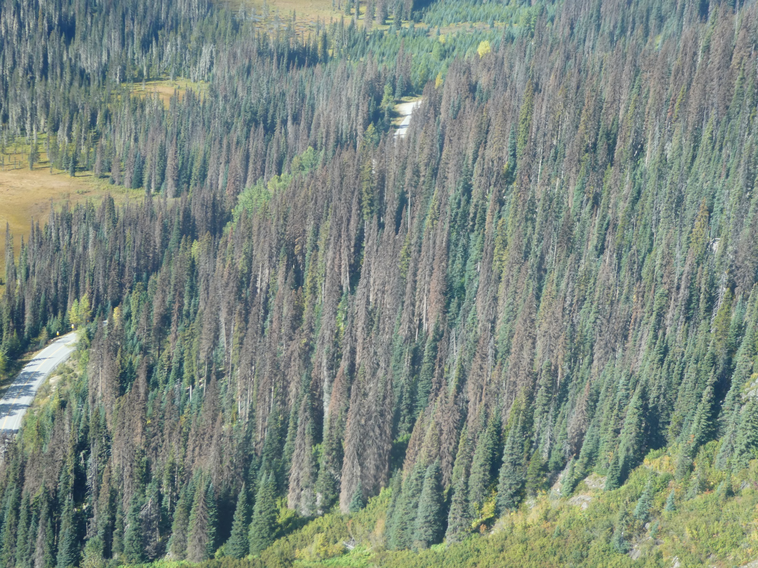

Slide 20
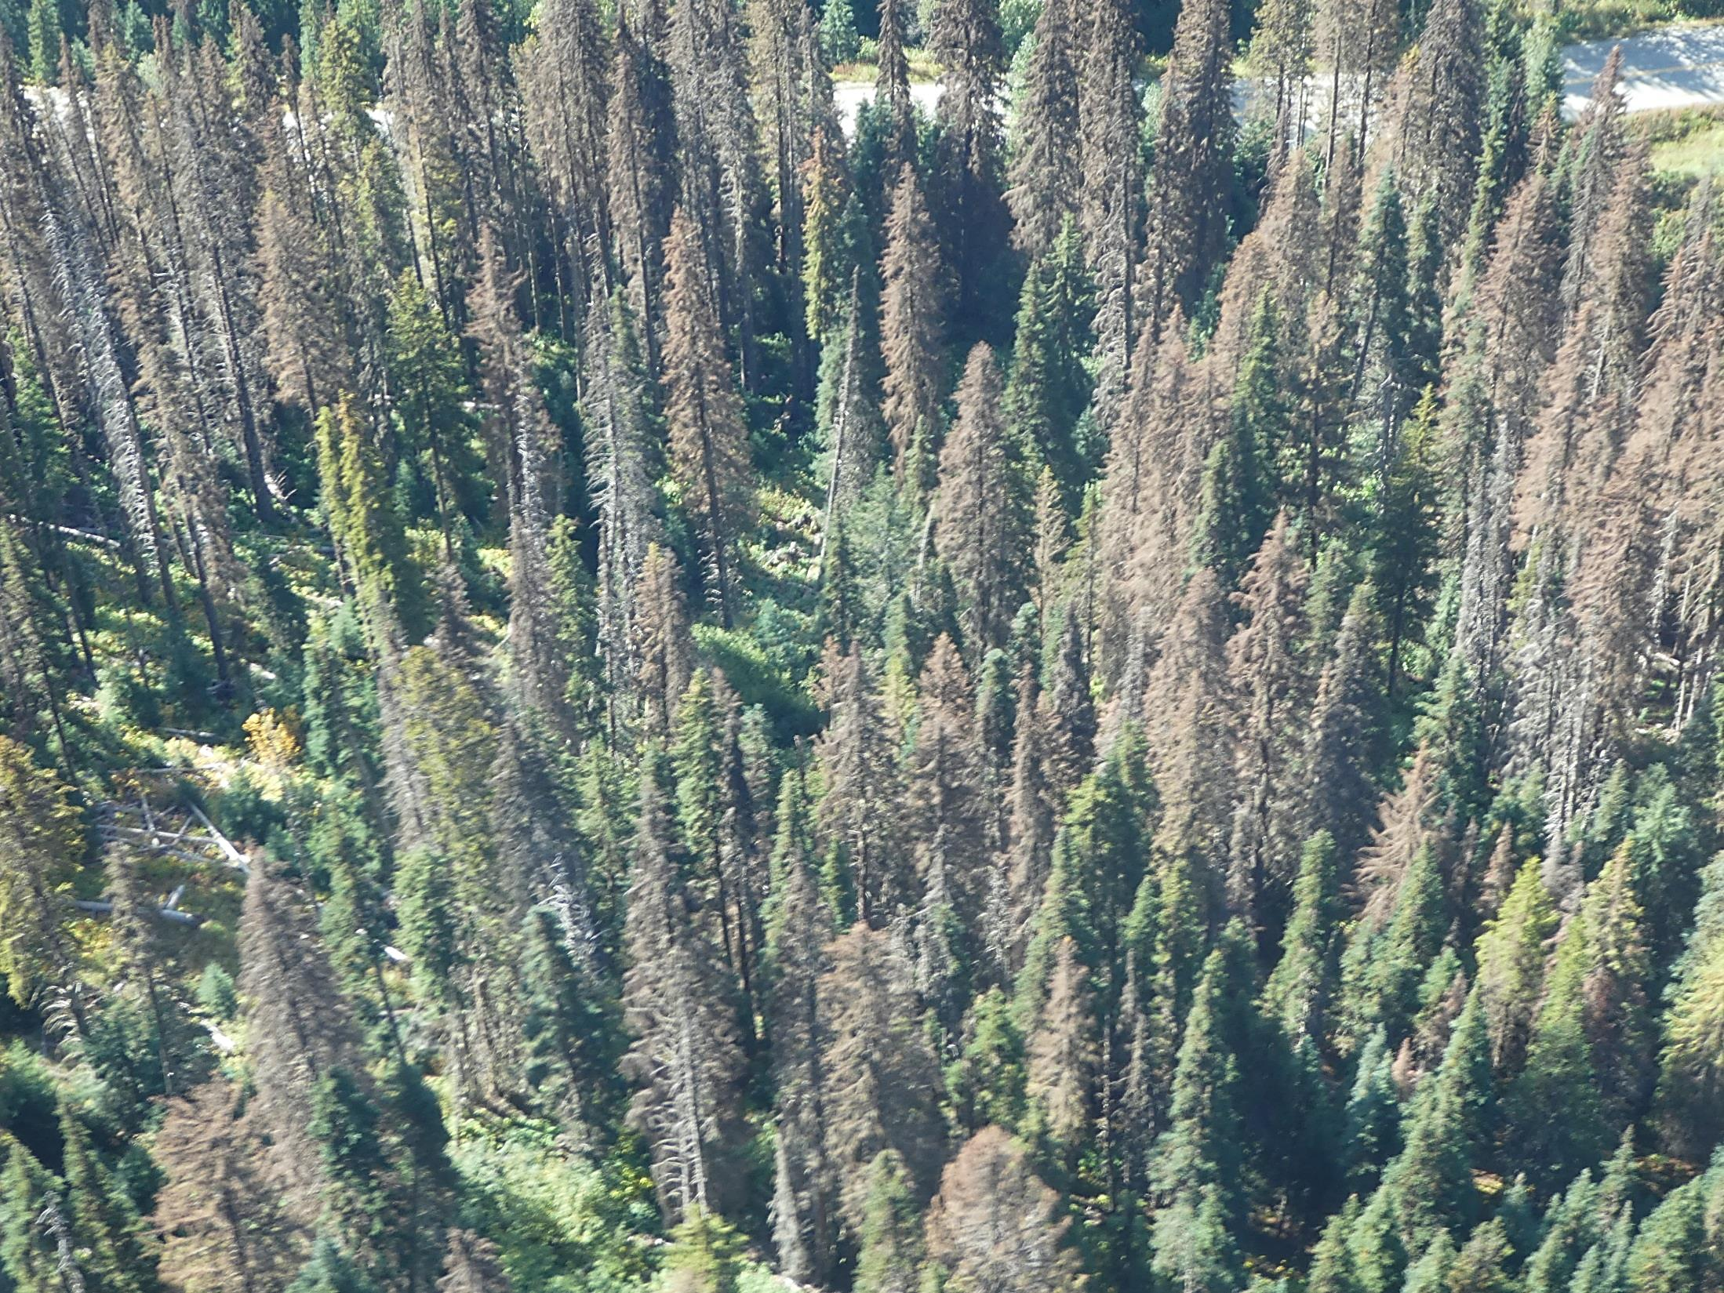
Spruce attack and fade

Slide 21
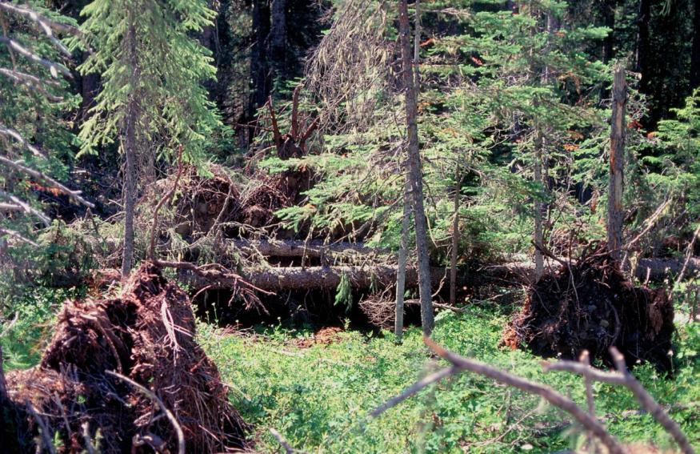
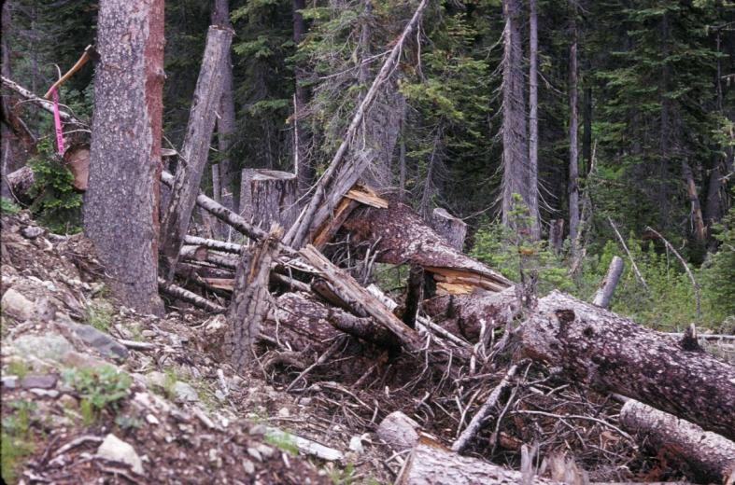
Spruce beetle host preferences –
Building populations
Blowdown
Larger slash and
stumps
Notes:
Lang Ck 1992 (DGO). Roadside slash generates SB attack on adjacent trees
SBB populations are complex and, non-linear in nature. They exhibit shifts from endemic to epidemic levels that are
catalyzed by specific events and therefore not reliably predictable. Climate is a major driver. Relationships between forest structure, composition, site, and spruce beetle occurrence in the Intermountain West USDA Forest Service Proceedings – RMRS-P-56 2009

Slide 22
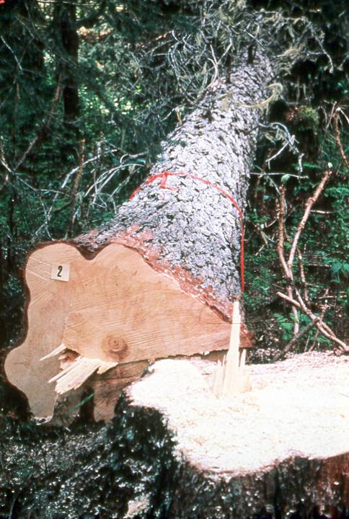

Management
Hazard assessment
detection
harvest
trap trees
lethal trap trees – no longer used
salvage blowdown
Ips

Slide 23

Distribution of spruce beetle in B.C.
Hazard rating identifies those stands where substantial losses can be expected if an outbreak of spruce beetle occurs.
This valuable planning tool identifies those stands that are highly susceptible to attack.
To determine stand hazard, the following formula is applied:
10 x (Q x A x P x L x S2) x 0.5
Where the formula factors are:
Q = Site quality (good = 1.14; medium = 0.60; poor = 0.27)
A = Age (> 120 = 1.21; 100-120 = 0.74, <100 = 0.07)
P = Proportion of susceptible basal area = (basal area of spruce > 17.5 cm)/(basal area of all species > 12.5 cm) x 100
L = Location = (24.4 x absolute longitude) – (121.9 x latitude) – (elevation (m)) + 4408.1)
S2 = Stand density and growth rate (see the following link to calculate):

Slide 24

Management: Clean up!
Notes:
Cupola Ck 1992 (DGO). Hi stumps and slash generate SB attack in drainage (centre: Kevin Edquist)

Slide 25

Management: Trap trees
Largest available healthy trees
Non-lethal Trap Trees – harvest (remove), peel or burn
Lethal Trap Trees - not often used anymore
How many? 1 trap tree for every 4 infested trees (in building phase of outbreak)
800 m apart

Slide 26
Management: Pheromones to reduce spruce beetle populations on downed trees - Repellent
MCH is anti-aggregation pheromone of the spruce beetle
Has been used to reduce spruce beetle attack on felled trees
Inconsistent results on standing trees.
(3-methylcyclohex-2-en-1-one)
Notes:
Pre-attack application of pheromones of competing beetle species has been used on downed trees to inhibit spruce beetle (SBB) attack and production, and allow secondary beetle species to successfully exploit the resource. These secondary beetles do not normally attack and kill healthy trees (Poland and Borden 1998). The treatment precludes development of SBB populations, but doesn’t actually directly kill many SBB.
MCH is anti-aggregation pheromone of the spruce beetle that has been used to reduce spruce beetle attack on felled trees, but has had inconsistent results on standing trees.
Treatment: Attract Ips tridens; ipsdienol @ 0.2 mg/day, and cis-verbenol 83:17 -:+ @ 0.6 mg/day (cis-verbenol perhaps not needed (Werner and Holsten 2002)?); plus
Attract Dryocoetes affaber; 1:1 racemic +/- endo-Brevicomin @ 0.2 mg/day; plus.
Repel SBB: standard available MCH device (Werner and Holsten 2002). Applying endo-B for D. affaber is probably sufficient.
Application: On blowdown: approximately 5 m spacing on -N- side of bole. Five m is an average of Poland and Borden 1998a and Werner and Holsten 2002.
On standing trees: one set of release devices on the north side of standing fire damaged trees.
References: Poland, T.M., and J.H. Borden. 1998. Competitive exclusion of Dendroctonus rufipennis induced by pheromones of Ips tridens and Dryocoetes affaber (Coleoptera: Scolytidae). J. Econ. Ent. 91:1150-1161.
Werner, R.A. and E.H. Holsten. 2002. Use of semiochemicals of secondary bark beetles to disrupt spruce beetle attraction and survival in Alaska. USDA Forest Service Research Paper PNW-RP-541.
Ross, D.W., G.E. Daterman, and A.S. Munson. 2004. Evaluation of the antiaggregation pheromone, 3-methylcyclohex-2-en-1-one (MCH), to protect live spruce from spruce beetle (Coleoptera: Scolytidae) infestation in southern Utah. J. Ent. Soc. British Columbia 101: 145-146.

Slide 27


Management: Pheromones to reduce spruce beetle populations on downed trees - Competitive exclusion
Pre-attack application of pheromones of competing secondary beetle species to promote exploitation of resource
Inhibits spruce beetle (SBB) attack and production
Has been used on downed trees
Attracts Ips tridens and Dryocoetes affaber
Early falling of infested trees - preventing emergence
Emergence of adults from standing trees to overwinter can be prevented by falling the infested trees before August.
Notes:
Pre-attack application of pheromones of competing beetle species has been used on downed trees to inhibit spruce beetle (SBB) attack and production, and allow secondary beetle species to successfully exploit the resource. These secondary beetles do not normally attack and kill healthy trees (Poland and Borden 1998). The treatment precludes development of SBB populations, but doesn’t actually directly kill many SBB.
MCH is anti-aggregation pheromone of the spruce beetle that has been used to reduce spruce beetle attack on felled trees, but has had inconsistent results on standing trees.
Treatment: Attract Ips tridens; ipsdienol @ 0.2 mg/day, and cis-verbenol 83:17 -:+ @ 0.6 mg/day (cis-verbenol perhaps not needed (Werner and Holsten 2002)?); plus
Attract Dryocoetes affaber; 1:1 racemic +/- endo-Brevicomin @ 0.2 mg/day; plus.
Repel SBB: standard available MCH device (Werner and Holsten 2002). Applying endo-B for D. affaber is probably sufficient.
Application: On blowdown: approximately 5 m spacing on -N- side of bole. Five m is an average of Poland and Borden 1998a and Werner and Holsten 2002.
On standing trees: one set of release devices on the north side of standing fire damaged trees.
References: Poland, T.M., and J.H. Borden. 1998. Competitive exclusion of Dendroctonus rufipennis induced by pheromones of Ips tridens and Dryocoetes affaber (Coleoptera: Scolytidae). J. Econ. Ent. 91:1150-1161.
Werner, R.A. and E.H. Holsten. 2002. Use of semiochemicals of secondary bark beetles to disrupt spruce beetle attraction and survival in Alaska. USDA Forest Service Research Paper PNW-RP-541.
Ross, D.W., G.E. Daterman, and A.S. Munson. 2004. Evaluation of the antiaggregation pheromone, 3-methylcyclohex-2-en-1-one (MCH), to protect live spruce from spruce beetle (Coleoptera: Scolytidae) infestation in southern Utah. J. Ent. Soc. British Columbia 101: 145-146.

